Slide 1
CSE 2201
Design and Analysis of Algorithms – I
Lecture 4
Euler Path, Minimum Spanning Tree (Kruskal)
Hasnain Heickal
Assistant Professor
Department of CSE, University of Dhaka

Slide 2
EULER CIRCUITS

Slide 3
Euler Circuits in Graphs
A sequence x₀, x₁, x₂, …, x_{t} of vertices is called an euler circuit in a graph G if:
x₀ = x_{t};
For every i = 0, 1, 2, …, t-1, x_{i} x_{i+1} is an edge of G; and
For every edge e of G, there is a unique i with 0 ≤ i < t so that e = x_{i} x_{i+1}.

Slide 4
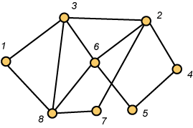
Euler Circuits in Graphs
Here is an euler circuit for this graph:
(1,8,3,6,8,7,2,4,5,6,2,3,1)

Slide 5
Euler’s Theorem
A graph G has an euler circuit if and only if it is connected and every vertex has even degree.

Slide 6
Euler’s Path
A graph G has an euler path if and only if it is connected and every vertex has even degree except two.

Slide 7
Algorithm for Euler Circuits
Choose a root vertex r and start with the trivial partial circuit (r).
Given a partial circuit (r = x₀,x₁,…,x_{t} = r) that traverses some but not all of the edges of G containing r, remove these edges from G. Let i be the least integer for which x_{i} is incident with one of the remaining edges. Form a greedy partial circuit among the remaining edges of the form (x_{i} = y₀,y₁,…,y_{s} = x_{i}).
Expand the original circuit:
r =(x₀,x₁,…, x_{i-1}, x_{i} = y₀,y₁,…,y_{s} = x_{i}, x_{i+1},…, x_{t}=r)

Slide 8
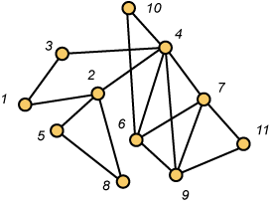
An Example
Start with the trivial circuit (1). Then the greedy algorithm yields the partial circuit (1,2,4,3,1).

Slide 9
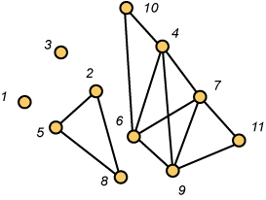
Remove Edges and Continue
Start with the partial circuit (1,2,4,3,1). First vertex incident with an edge remaining is 2. A greedy approach yields (2,5,8,2). Expanding, we get the new partial circuit (1,2,5,8,2,4,3,1)

Slide 10
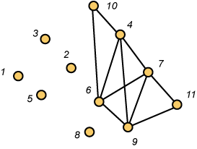
Remove Edges and Continue
Start with the partial circuit (1,2,5,8,2,4,3,1). First vertex incident with an edge remaining is 4. A greedy approach yields (4,6,7,4,9,6,10,4). Expanding, we get the new partial circuit (1,2,5,8,2,4,6,7,4,9,6,10,4,3,1)

Slide 11
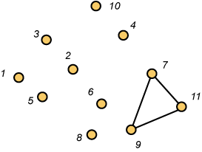
Remove Edges and Continue
Start with the partial circuit (1,2,5,8,2,4,6,7,4,9,6,10,4,3,1) First vertex incident with an edge remaining is 7. A greedy approach yields (7,9,11,7). Expanding, we get the new partial circuit (1,2,5,8,2,4,6,7,9,11,7,4,9,6,10,4,3,1). This exhausts the edges and we have an euler circuit.

Slide 12
Tutorial
http://www.dcc.fc.up.pt/~pribeiro/estagio2008/usaco/3_3_EulerianTour.htm

Slide 13
MINIMUM SPANNING TREE

Slide 14
Problem: Laying Telephone Wire
Central office

Slide 15
Wiring: Naïve Approach
Central office
Expensive!

Slide 16
Wiring: Better Approach
Central office
Minimize the total length of wire connecting the customers

Slide 17
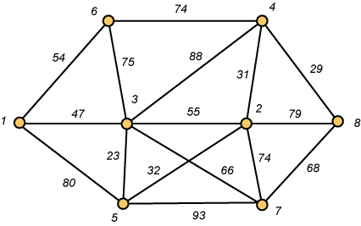
A Networking Problem
Problem: The vertices represent 8 regional data centers which need to be connected with high-speed data lines. Feasibility studies show that the links illustrated above are possible, and the cost in millions of dollars is shown next to the link. Which links should be constructed to enable full communication (with relays allowed) and keep the total cost minimal.

Slide 18
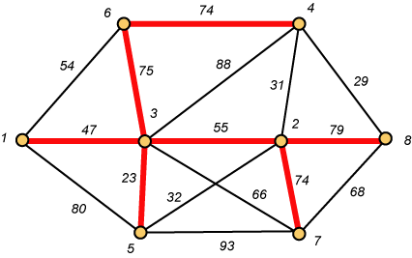
Links Will Form a Spanning Tree
Cost (T) = 47 + 23 + 75 + 74 + 55 + 74 + 79
= 427

Slide 19
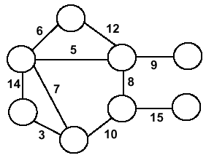
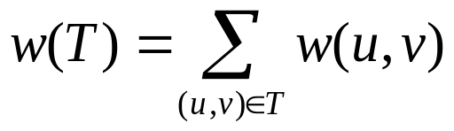
Minimum Spanning Trees
Undirected, connected graph G = (V,E)
Weight function W: E → R (assigning cost or length or other values to edges)
Spanning tree: tree that connects all the vertices (above?)
Minimum spanning tree: tree that connects all the vertices and minimizes

Slide 20
Minimum Spanning Tree (MST)
A minimum spanning tree is a subgraph of an undirected weighted graph G, such that
it is a tree (i.e., it is acyclic)
it covers all the vertices V
  contains |V| - 1 edges
the total cost associated with tree edges is the minimum among all possible spanning trees
not necessarily unique

Slide 21
How Can We Generate a MST?
9
b
9
b
a
2
6
a
2
6
d
d
4
5
4
5
5
4
5
4
5
e
5
e
c
c

Slide 22
Greedy Choice
We will show two ways to build a minimum spanning tree.
A MST can be grown from the current spanning tree by adding the nearest vertex and the edge connecting the nearest vertex to the MST. (Prim's algorithm)
A MST can be grown from a forest of spanning trees by adding the smallest edge connecting two spanning trees. (Kruskal's algorithm)

Slide 23
Kruskal's Algorithm
Edge based algorithm
Add the edges one at a time, in increasing weight order
The algorithm maintains A – a forest of trees. An edge is accepted it if connects vertices of distinct trees
We need a data structure that maintains a partition, i.e.,a collection of disjoint sets
  MakeSet(S,x)
  Union(S_{i},S_{j})
  FindSet(S, x)

Slide 24
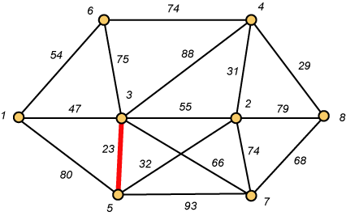
Kruskal – Step 1

Slide 25
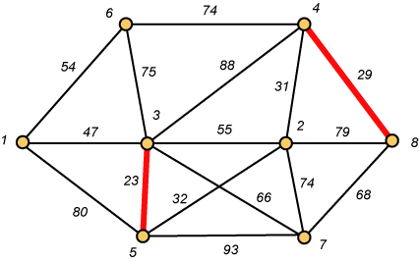
Kruskal – Step 2

Slide 26
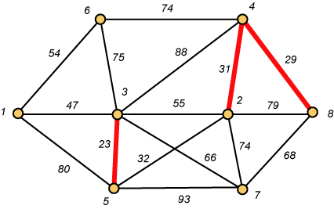
Kruskal – Step 3

Slide 27
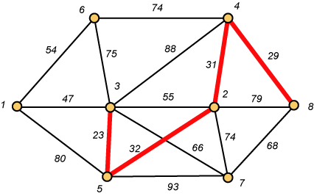
Kruskal – Step 4

Slide 28
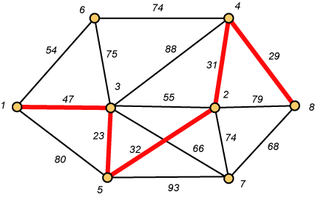
Kruskal – Step 5

Slide 29
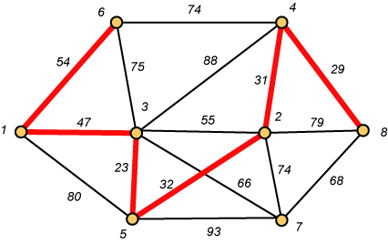
Kruskal – Step 6

Slide 30
Why Avoiding Cycles Matters
Up to this point, we have simply taken the edges in order of their weight. But now we will have to reject an edge since it forms a cycle when added to those already chosen.

Slide 31
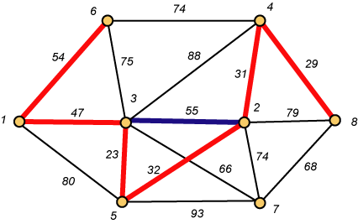
Forms a Cycle
So we cannot take the blue edge having weight 55.

Slide 32
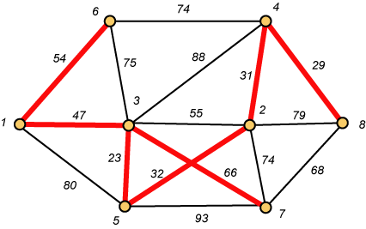
Kruskal – Step 7 DONE!!
Weight (T) = 23 + 29 + 31 + 32 + 47 + 54 + 66 = 282

Slide 33
Disjoint-Set
Keep a collection of sets S₁, S₂, .., S_{k},
  Each S_{i} is a set, e,g, S₁={v₁, v₂, v₈}.
Three operations
  Make-Set(x)-creates a new set whose only member is x.
  Union(x, y) –unites the sets that contain x and y, say, S_{x} and S_{y}, into a new set that is the union of the two sets.
  Find-Set(x)-returns a pointer to the representative of the set containing x.

Slide 34
Kruskal's Algorithm
The algorithm adds the cheapest edge that connects two trees of the forest
MST-Kruskal(G,w)
01 A ← ∅
02 for each vertex v ∈ V[G] do
03 Make-Set(v)
04 sort the edges of E by non-decreasing weight w
05 for each edge (u,v) ∈ E, in order by non-decreasing weight do
06 if Find-Set(u) ≠ Find-Set(v) then
07 A ← A ∪ {(u,v)}
08 Union(u,v)
09 return A
O(V)
O(ElogE)
O(E)
O(V)
Overall Complexity: O(VE)

Slide 35
Question
Exercise
  23.2.7 – Add new vertices & edges in a graph
  23-1: Second best minimum spanning tree

